Slide 1


Titolo presentazione sottotitolo
A Clinical Validation Tool for Children
Serious Games
Milano, XX mese 20XX

Slide 2
Table of contents
Starting point: Google-Playstore.csv
Filtering Potential “Serious Game”
Filtering out Not Games or Renamed Apps
Enriching the Dataset with Descriptions and Reviews
Keywords Extraction with Natural Language Processing (NLP)
Benchmark For Game Selection
Benchmark Results
Build Dataset with Pubmed Papers
Reliability of Pubmed papers
Threshold for Clinical Validation
Similarity Function for Not Validated Games
Benchmark for Game Validation
Benchmark Results
Dashboard

Slide 3
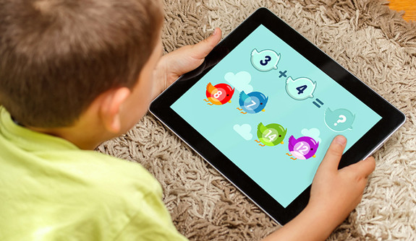

PROJECT PURPOSE
Nowadays children are increasingly involved in using mobile games
We developed an informatic tool to validate serious games from a clinical point of view found on

Slide 4

Starting point: Google-Playstore.csv
We choosed a Google-PlayStore database provided by
Kaggle to import it in our code as first source
Very detailed database containing several features
Highly compatible with the
google-play-scraper library
Back

Slide 5


Filtering Potential “Serious Game”
Our purpose is to filter out all those applications that can potentially be evaluated as “serious games”
According to the solution we implemented, we based our filter on:
Educational Category selection
Rating threshold
Minimum Rating Counts
Back

Slide 6



Filtering out Not Games or Renamed Apps
Check the
subcategory
Renamed
or deleted Drop!
Google Play Scraper
Not found in csv file
Not games Drop!
Google Play Scraper
Back

Slide 7



Enriching the Dataset with Descriptions and Reviews
Import
attributes
missing
Extract other important
parameters
Number of Reviews Add!
Google Play Scraper
Conjunction with rating counts
Game Description Add!
Google Play Scraper
Back

Slide 8




Keywords Extraction with Natural Language Processing (NLP)
Classify the filtered games according to its
specific Learning Category and Age Range
Parameters not found in Kaggle dataset
nor with Google-Play-Scraper
We build a set of keywords related to different 'Learning category' and 'Age range' defined by us. The 'Learning category' and 'Age range' are thus assigned based on afference of the keywords found in the Description
Back

Slide 9
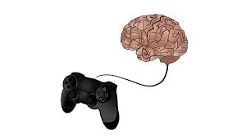






Benchmark For Game Selection
40 Serious Games
40 Non Serious Games
40 Random Games
120 Application
Benchmark idea: verify that our algorithm has ideally
selected all the serious games and filtered out
not the serious ones and the random apps
Back

Slide 10




Benchmark Results
EVALUATION
Relative Accuracy
85%
Accruacy
92.5%
Sensitivity
77.5%
Specificity
100%
Distinguish a serious game and non-serious one or any other application
Recognize a
serious game
Recognize a
non-serious
game
Measures the ability to focus on serious games
Back

Slide 11
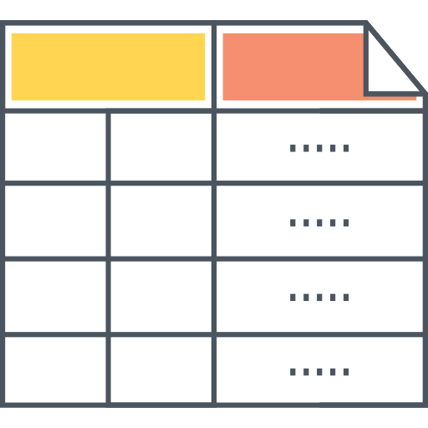


Build Dataset with Pubmed Papers
App
name
Learning
category
Associated papers from PubMed
Help to establish contact with
non-validated games
Help to find scientific evidence and validate from a clinical point
Back

Slide 12
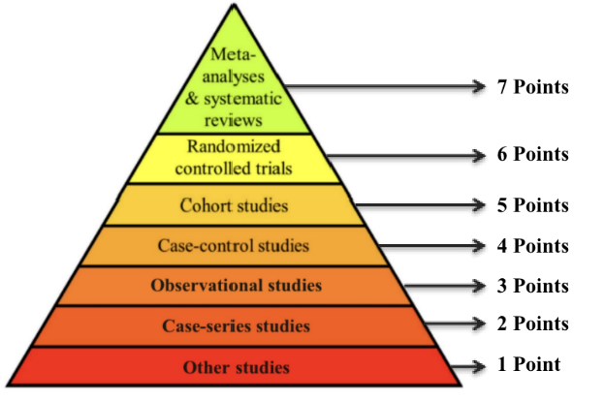




Reliability of Pubmed papers
Provide a Validation Score for serious games based on robustness and reliability of associated papers on Pubmed
Implement a function that rewards the relevance of keywords associated to clinical studies with higher reliability in the different sections of the papers
Back

Slide 13
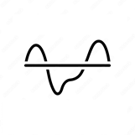
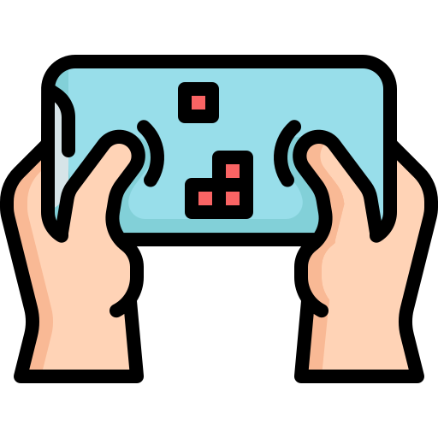


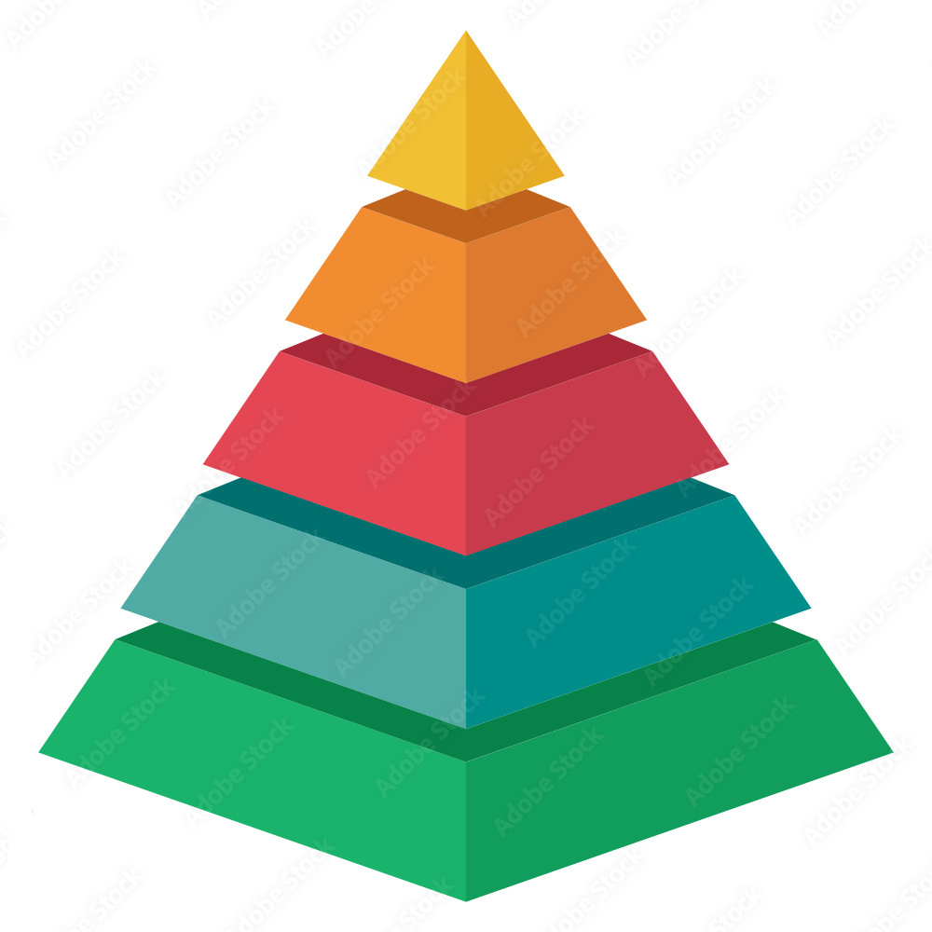

Threshold for Clinical Validation
Not Validated Games
Validated Games
We considered the presence of a keyword related to an observational study as a threshold for validation
Back

Slide 14


Similarity function for Not Validated Games
Find a solution to give reliability to all those games not validated
Validated Games
Learning Category
Not Validated Games
Back

Slide 15



Benchmark for Game Validation
29 serious games on Pubmed validated by human
5 serious games on Pubmed judged by human as not validated
Benchmark idea: Compare the clinical validation
of a serious game made by our algorithm
to that made by human being
Back

Slide 16
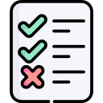


Benchmark Results
EVALUATION
Accruacy
92.5%
Sensitivity
77.5%
Specificity
100%
Distinguish between a validated serious game and not validated serious one
Recognize a validated serious game
Recognize a not validated serious game
Back

Slide 17





Dashboard
To display all mentioned information
Available serious games per Learning Category and Age Range?
Level of Clinical Validation associated a given serious game?
Level of validation of a given paper according to its study type?
Similar validated application for a not validated game?

